Slide 1
“Look at me!” --
An Creative Examination of the Female Body
Jiayi Hao 24’
Mediart 206 Midterm Presentation

Slide 2
Background: Bodies
Our bodies are more than physical, protective structures
Holds our identities and shapes our experiences
An integral part of the self - what makes us “us”

Slide 3
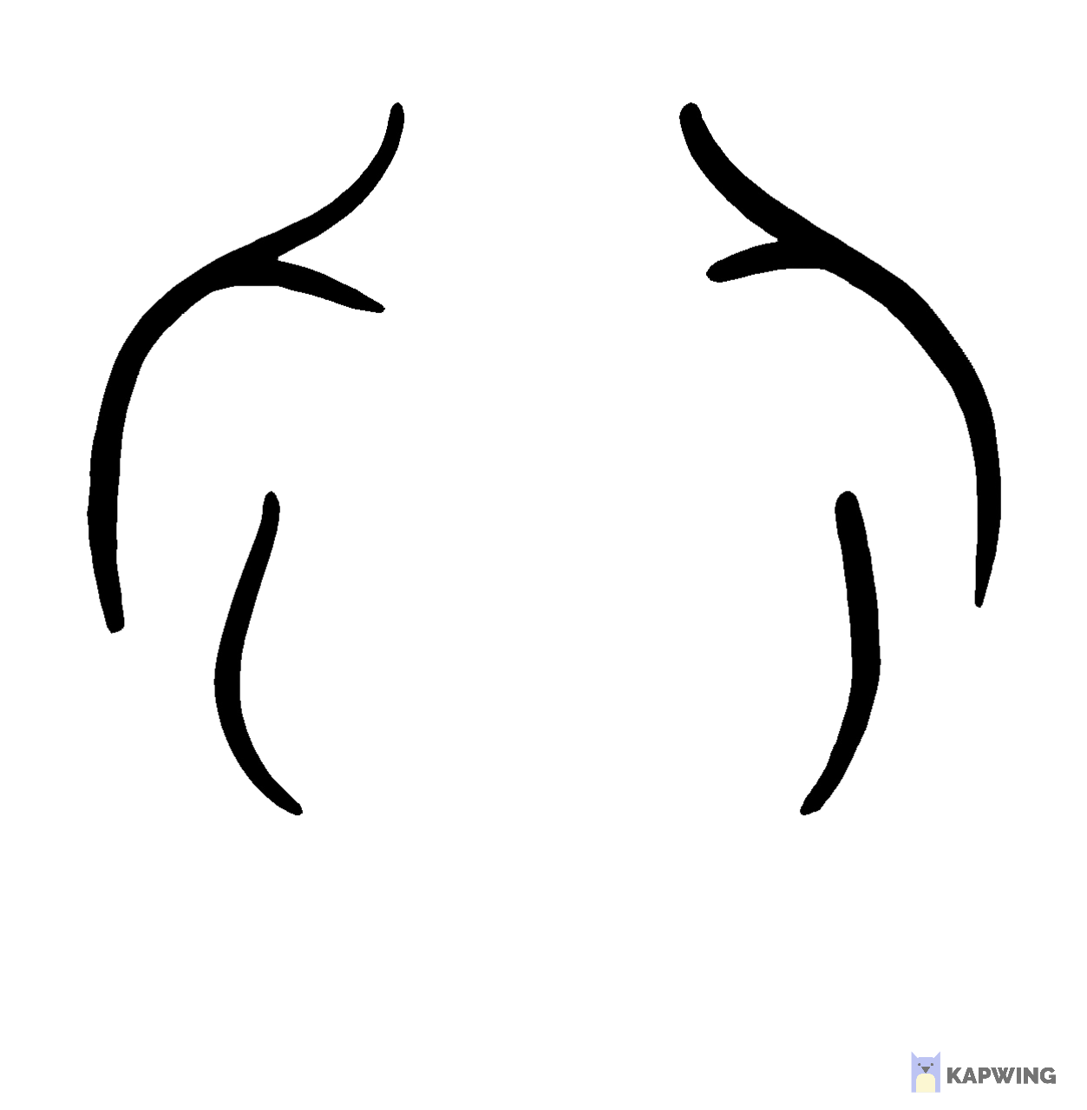
The Female Body
In patriarchal societies, the female body is often objectified and being stared upon
How others gaze upon female-identifying individuals’ bodies is closely correlated to their lived and living experiences
Body shaming, eating disorders etc. are more common in female-identifying individuals

Slide 4
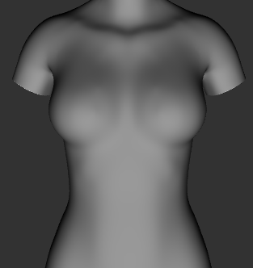
Concept of the Project
To explore the female body and how it can be displayed in a imagined, surreal and digitally created space, while examining how such a portrayal reflects back into reality and unveils social issues
2D → 3D

Slide 5

Spaces - 2 Dimensional Portrayal
Particle System
ofImage()
ofPolyline()
ofMap()
sin()
MousePressed()
...

Slide 6
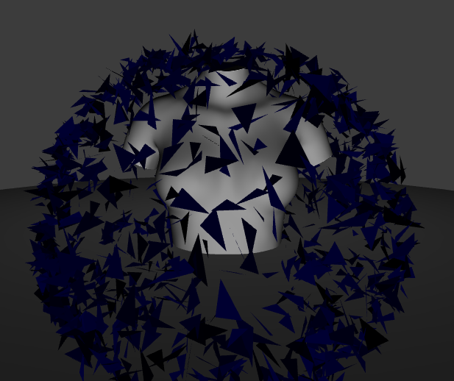
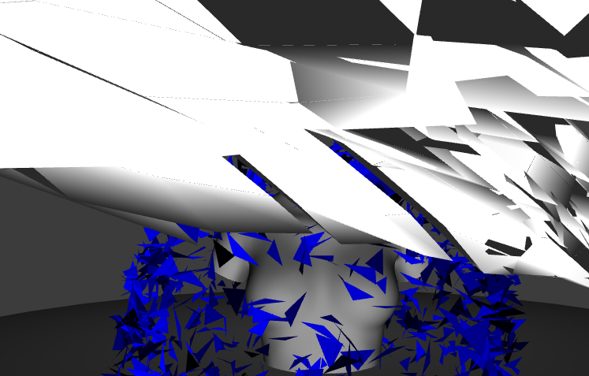
Spaces - 3 Dimensional Portrayal
ofMesh()
3DPrimitives
Assimp Addon
ofTranslate()
ofRotate()
Perlin Noise
...

Slide 7
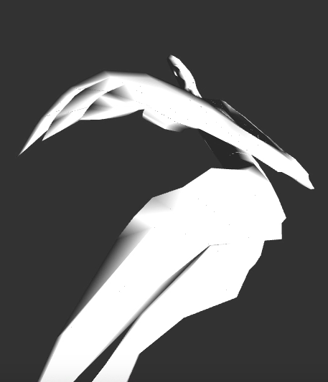
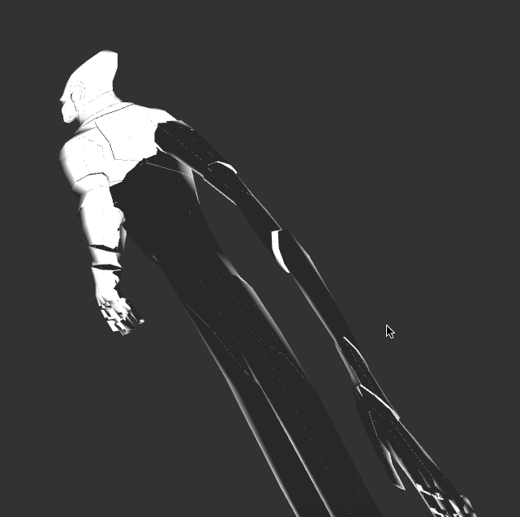
3D Spirit: Metaphoriccal Individual liberation

Slide 8

User Instructions

Slide 9
Thank You!

